Slide 1
Keycloak for Auth and User Management

Slide 2
Events in the life of a user
Provisioning
Authentication
Authorization
Session
Account Management
Logout
Deprovisioning

Slide 3
Our current authentication flow
app.bigco.in
app.bigco.in
Token:
It is stateless and self contained
It has limited lifespan
It is a standard JWT token
App frontend
App server
/login
token
Generates token
Stores token
/client/201 +
token
{“id”: 201, “name”: …}
Verifies token

Slide 4
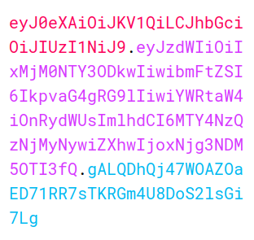
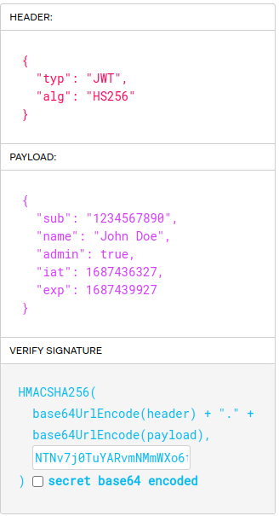
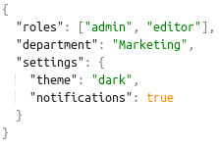
JSON Web Token
Open Standard (RFC 7519)
Header.Payload .Signature
Contains claims about the user
Digital signature ensures data integrity and authenticity
Registered claims
  “iss” (Issuer)
  “aud” (Audience)
  “nbf” (Not Before)
  “jti” (JWT ID)
Custom claims
Decode
Encoded Token String
Notes:
Word of warning base64 is encoding not encryption. So, make sure they are sent through a secure channel.

Slide 5
Problems With That Architecture
Long token expiry
Risk of stale token info and token leakage causing damage
App server and auth server are the same
We implement the critical functionality of user management, authentication and authorization
Problems with logouts

Slide 6



Modern Authentication Flow
app.bigco.in
auth.bigco.in
User
Browser
App FE
Auth server
User clicks on Login button
The user’s browser redirected to the Auth server with an authentication request.
The Auth server interacts with the user for authentication.
The user authenticates and the Auth server creates an authentication session for the user.
The user’s browser redirected back to the application with authorization code.
The application sends a token request to the Auth server, with the authorization code.
The Auth server responds with Access Token, Refresh token, and ID token.
1
Click Login button
2
Redirect to auth server
3
Show login form
4
Send credentials
5
Redirect to the app
6
/token
7
Access token
Refresh token
ID token

Slide 7
Demo

Slide 8
PKCE - More Secure
Client App
Browser
Auth Server
Client App
Browser
Auth Server
Send Auth request
1. Rand code verifier
2. Code challenge = SHA256(verifier)
Send Code challenge in Auth request
Store challenge
Send authz code in redirect URL
Authz code
Gets Authz code from the URL
/token + code verifier + authz code
/token + authz code
Verify code
tokens
tokens
Notes:
Postman analogy

Slide 9
Tokens in the modern flow
Access Token
  Grants access to protected resources
  Short lived (minutes)
  Sent in HTTP Authorization header when accessing resources
Authorization: Bearer eyJhbGciOiJSUzI1NiIsInR5cCIgOiAiS
Refresh Token
  Obtains new tokens without reauthentication
  Long lived (hours, days)
  Sent in a request to /token to get a new access token
ID Token
  Provides user identity information to the client
  Short lived (minutes)
  It is meant to be used by the client only. So, it is not sent in web service requests

Slide 10
Keycloak
Open source
Maintained by Redhat
Built with Java and supports Postgres, Oracle, MS SQL, etc.
Mature and actively developed. First release was in 2014.
Builds on industry standard protocols OIDC, OAuth, etc.
Web based GUI for administrators and end-users
RESTful API and cli tool for admins

Slide 11
Backend Service Integration
User
Authenticated user interacts with the app
App sends Access Token in Authorization header of the request
Service looks up the Public key using kid from JWT
Service verifies the signature, checks access and returns data
1
click on Clients List
App
Backend Service
2
/clients
4
Verify the token and process request
kid
3
Public key
Keycloak
Access token
Refresh token
ID token

Slide 12

Optimizing Token Verification Approaches
Cache
Cache
3
3
Store a verified token or lookup
Lookup result
Store PK
Retrieve PK
1
1
Verify token
1
Process based on lookup result
App
Access token
Service
App
Access token
Service
4
App
Access token
Service
4
2
Verify token
Verification result
2
2
Send token for verification
Verification result
Retrieve PK using kid
Keycloak
Keycloak
Keycloak
High Security, Slow
Moderate Security, Medium Speed
Low Security, Fast

Slide 13
User Registration Approaches
erp.bigco.in
auth.bigco.in
social.bigco.in
api.bigco.in
auth.bigco.in
Client app
Keycloak
Client app
Signup Web Service
Keycloak
Signup Button
Submit Signup Form
Open Signup Page
/signup
Signup Form
Process the request
Submit Signup Form
/user
Create user
Create user
To redirect URL
response
response
Customization possible but limited
More secure because Keycloak handles it
No development and maintenance effort
Full control over registration process
Must ensure proper security
Must maintain custom web service

Slide 14


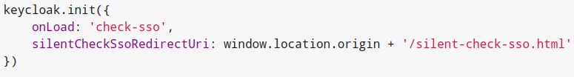
SSO
4
1
Browser
5
User logs into ERP
Keycloak creates a session and sends a cookie
Browser redirects to ERP
User opens Intranet
Intranet redirects the browser to Keycloak
Browser sends the cookie with the request to Keycloak
Keycloak checks if the session is valid
Redirects the user to Intranet
2
6
App 1 ERP
3
Keycloak
8
App 2 Intranet
erp.bigco.in
auth.bigco.in
intranet.bigco.in
7
Check if the session is valid
Session
Cookie

Slide 15
Authorization
Deny users with the "Marketer" role to launch campaigns outside office hours.
Deny users with the "Marketer" role to launch campaigns outside office hours.
Resource: campaign
Scope: Launch
Policy: 1) user with “Marketer” role
2) during office hours
Role Based + Time Based
Permission: Combines all the above representing our original authz requirement
Fine Grained Access Control
Resource: Object
  blog, user, voucher
Scope: Action
  create, delete, launch, share
Policy: Rule
  Deny an action if user has an attribute
  Allow an action if time of day is business hours
Permissions: Authorization
  Ties together resource, scope and policy
  X CAN DO Y ON RESOURCE Z
Notes:
"Allow users with the "CampaignLauncher" role to launch campaigns using email templates during office hours only."
In simple English, the permission statement for our example would be:
Users who have the "CampaignLauncher" role are allowed to launch campaigns using email templates, but they can do so only during office hours.
In simple English, the policy statement for our example would be:
Access is granted if the user's action occurs during office hours.
a policy does not directly reference resources or scopes
a policy focuses on defining the conditions under which access is granted or denied, based on various factors like user attributes, client attributes, roles, time of day, or custom logic.
While policies do not directly tie in resources or scopes, they do have an indirect relationship with them through permissions. Permissions combine resources, scopes, and one or more policies to create specific access control rules.
In other words, the permission is the component that links the resource, scope, and policy together in Keycloak for fine-grained access control decisions. The policy provides the general conditions for granting access, and the permission associates those conditions with a specific resource and scope.
To summarize, policies in Keycloak do not directly deal with resources or scopes. Their primary purpose is to define the conditions under which access is granted or denied. It's the permissions that combine resources, scopes, and policies to create specific access control rules.

Slide 16
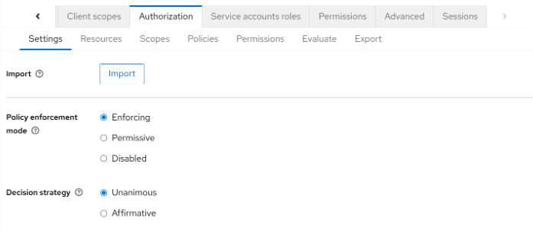

Slide 17
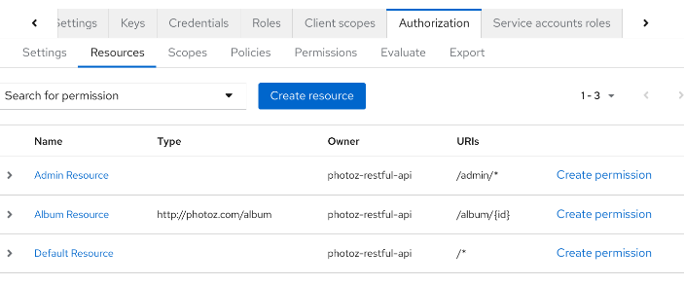

Slide 18
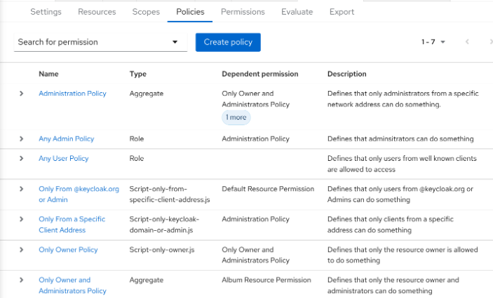

Slide 19
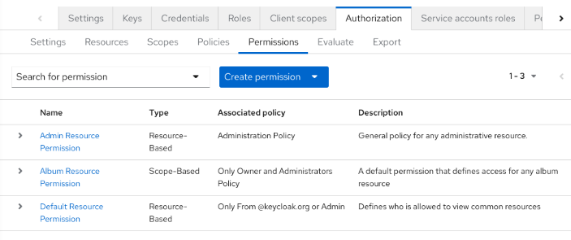

Slide 20
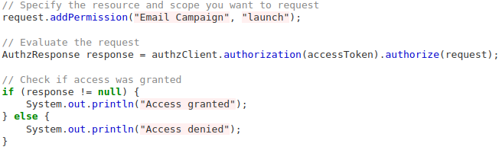
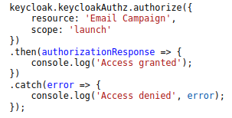
Evaluation
Java
Javascript

Slide 21
Account Management
Personal Info
Password Update
Active Sessions
2FA Setup

Slide 22
Logout
Single Sign-out
Front-Channel Logout
  The user clicks on logout button on App1
  App1 executes logout sequence and calls /logout of Keycloak
  The hidden iframe accesses App2 logout URL
Back-Channel Logout
  The user clicks on logout button on App1.
  App1 executes logout sequence and calls /logout of Keycloak
  Keycloak invokes App2's logout endpoint, asking it to remove the user's session.

Slide 23
Audit logs
Login Events:
Login
Register
Logout
Refresh token
Account Events:
Update Email
Update Profile
Update Password
Verify Email
11:36:09,965 WARN [org.keycloak.events] (default task-51) type=LOGIN_ERROR realmId=master clientId=erp userId=19aeb848-96fc-44f6-b0a3-59a17570d374 ipAddress=203.123.40.1 error=invalid_user_credentials auth_method=openid-connect auth_type=code redirect_uri=http://erp.merce.co/ code_id=b669da14-cdbb-41d0-b055-0810a0334607 username=admin

Slide 24
User Federation
Connects external user stores like LDAP, Active Directory, etc.
Custom user storage using User Storage SPI
Sync and import users
Delegate authentication
  Social Logins like Google, Facebook, Github, etc.
  Any other OpenID Connect server
  LDAP servers
Attribute mapping

Slide 25
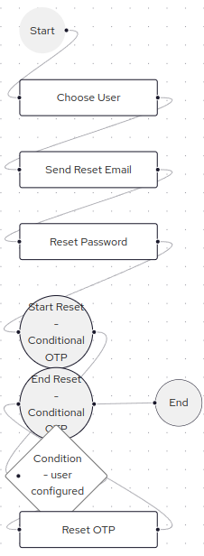
Keycloak is extensible
Service Provider Interface
Some SPIs
  Authentication
  User Storage
  Event Listener
  Theme Selector
SPIs Developed By Merce
  SMS OTP Based 2FA
  Geolocation based auth control
Customizing authentication flow

Slide 26
Changing the look and feel
Custom themes using FreeMarker templates, CSS and JS
Themes for
  Login, signup pages
  Admin console
  Email templates
Supports internationalization (i18n)

Slide 27
Integrating Applications With Keycloak
Keycloak adapters
  Java, Spring Boot, Spring Security, Servlet Filter, Tomcat, Jetty, and so on
  Javascript, Angular, Node, and so on
OpenID certified libraries https://openid.net/developers/certified/
  PHP, Go, Python, Ruby, and so on
Reverse Proxies
  OAuth2 Proxy
  Mod_auth_openidc Apache module
Or any generic OIDC implementation
Notes:
Proxy can be helpful for legacy applications that cannot easily modified

Slide 28
Thank you!

Slide 29











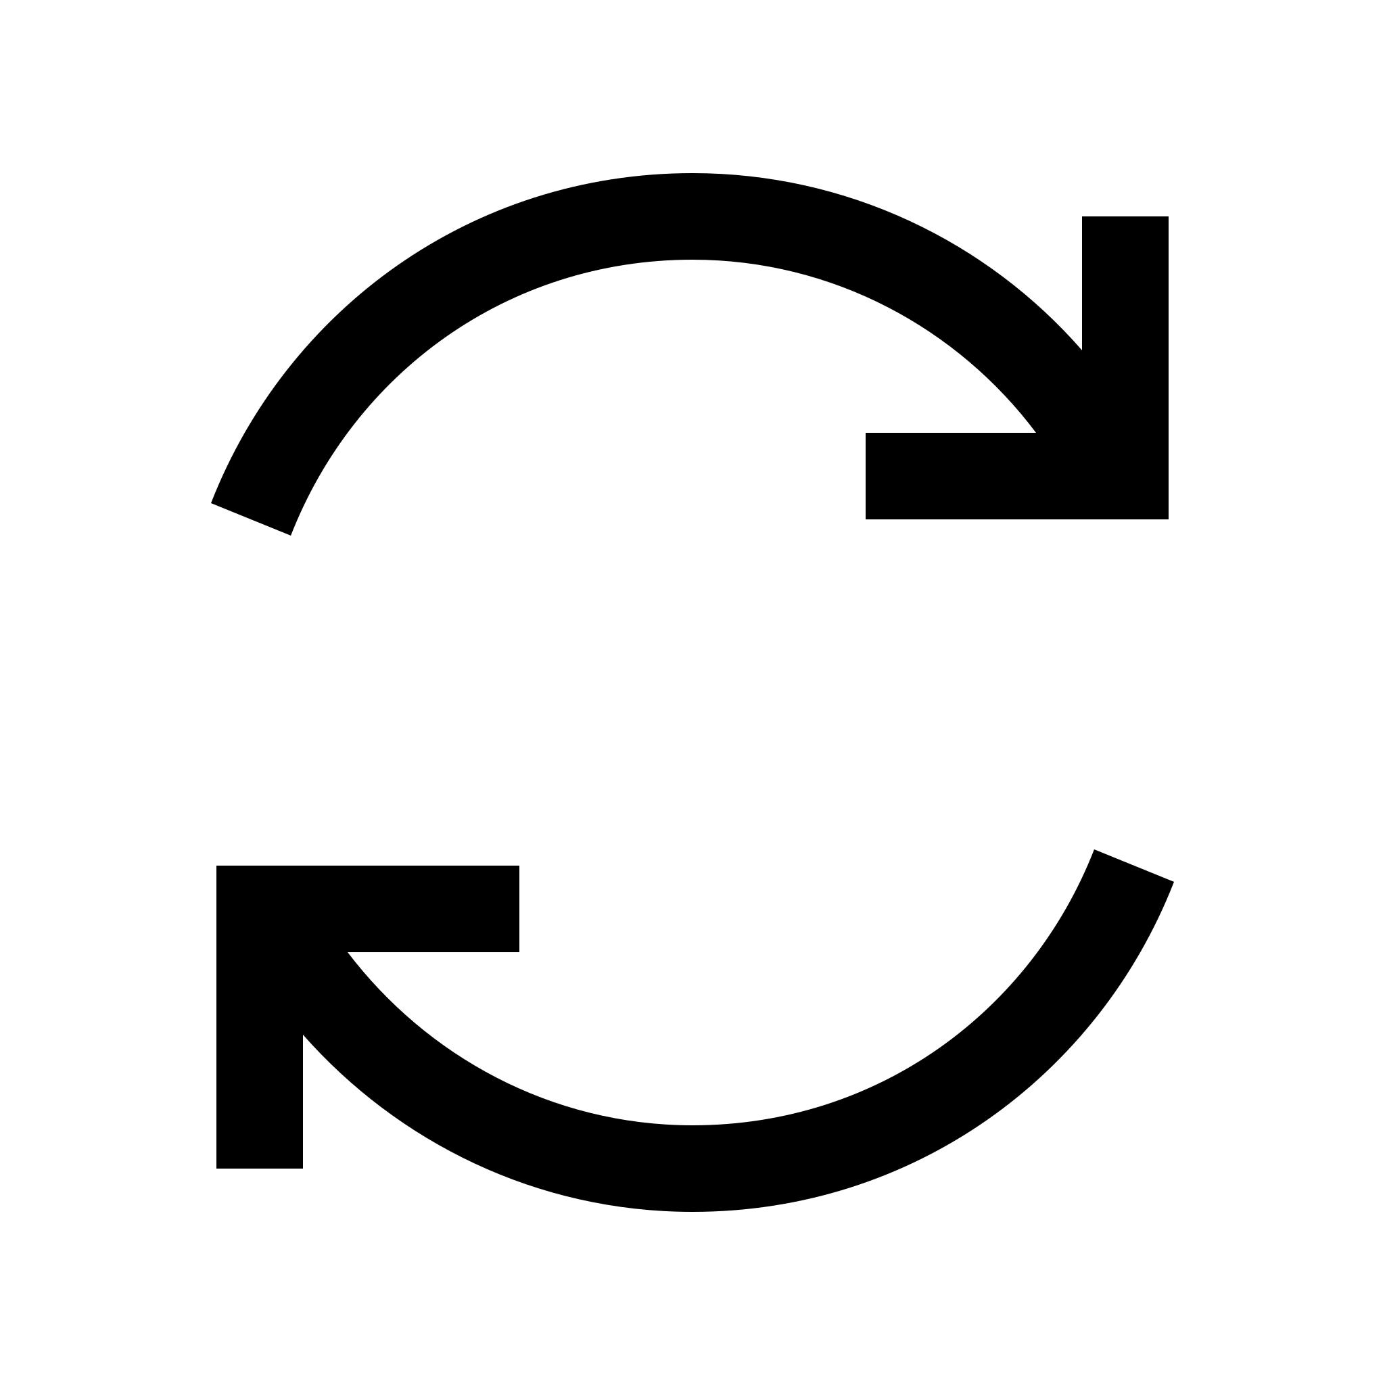




Assets
1
2
3
4

Slide 31
Text
Content

Slide 32
Text
Text

Slide 33
Text

