Slide 1
Keycloak for Auth and User Management
Part 2

Slide 2
Keycloak
Open source
Maintained by Redhat
Built with Java and supports Postgres, Oracle, MS SQL, etc.
Mature and actively developed. First release was in 2014.
Builds on industry standard protocols OIDC, OAuth, etc.
Web based GUI for administrators and end-users
RESTful API and cli tool for admins

Slide 3
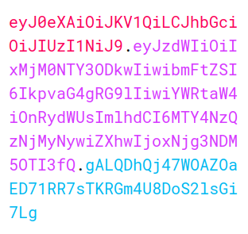
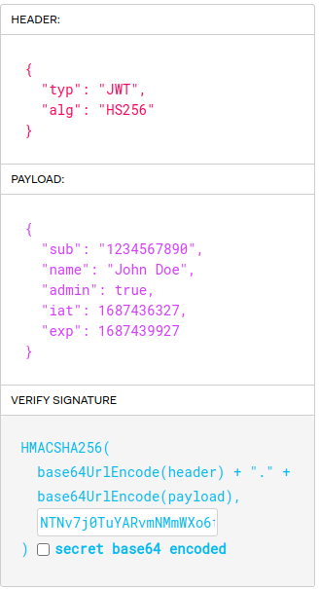
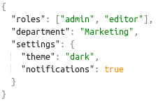
JSON Web Token
Open Standard (RFC 7519)
Header.Payload .Signature
Contains claims about the user
Digital signature ensures data integrity and authenticity
Registered claims
  “iss” (Issuer)
  “aud” (Audience)
  “nbf” (Not Before)
  “jti” (JWT ID)
Custom claims
Decode
Encoded Token String
Notes:
Word of warning base64 is encoding not encryption. So, make sure they are sent through a secure channel.

Slide 4



Tokens in the modern flow
Access Token
  Grants access to protected resources
  Short lived (minutes)
  Sent in HTTP Authorization header when accessing resources
Authorization: Bearer eyJhbGciOiJSUzI1NiIsInR5cCIgOiAiS
Refresh Token
  Obtains new tokens without reauthentication
  Long lived (hours, days)
  Sent in a request to /token to get a new access token
ID Token
  Provides user identity information to the client
  Short lived (minutes)
  It is meant to be used by the client only. So, it is not sent in web service requests

Slide 5
Keycloak : What are we learning today?
Understand Keycloak terminologies:
  Realm
  Client
  User
  Roles
Understanding flow for authentication.
Setting up keycloak Realm, Client, User, Role.
Configuring Keycloak use in Spring Boot application.
Extending Keycloak functionality a.k.a SPI.
Using the SPI we created for Merce.
Using Keycloak Admin API to manage keycloak.
Adding custom attributes to Keycloak’s User and include it in the Token

Slide 6
Keycloak Terminology : Realm
A Realm is a space where you manage objects including users, applications, roles etc.
Realms are isolated from one another and can only manage and authenticate the users that they control.
When deciding what realms you need, consider the kind of isolation you want to have for your users and applications.
A simple way to use a Realm is by Business Entity for example:
  MerceRealm : for Merce internal applications.
  NSDLRealm : for NSDL applications.
  CDSLRealm : for CDSL applications.
  ProteanRealm : for Protean applications.
Key Idea here is “ISOLATION” needed for the requirement.

Slide 7
Keycloak Terminology : Client
Clients are entities that can request Keycloak to authenticate a user.
Most often, clients are applications and services that want to use Keycloak to secure themselves and provide a single sign-on solution.
Clients can also be entities that just want to request identity information or an access token so that they can securely invoke other services on the network that are secured by Keycloak.
Example of Client:
  springboot-app
  php-app
  angular-app

Slide 8
Keycloak Terminology : User
Users are entities that are able to log into your system.
They can have attributes associated with themselves like email, username, address, phone number, and birthday.
They can be assigned group membership and have specific roles assigned to them.
We can add any custom attribute to Keycloak User and can retrieve it as a part of Keycloak user object.
User example: bhavya@merce.co

Slide 9
Keycloak Terminology : Role
Roles identify a type or category of user.
Admin, user, manager, and employee are all typical roles that may exist in an organization.
Applications often assign access and permissions to specific roles rather than individual users as dealing with users can be too fine-grained and hard to manage.
Roles are embedded into the User access Token which the downstream applications can use to manage authorization.

Slide 10
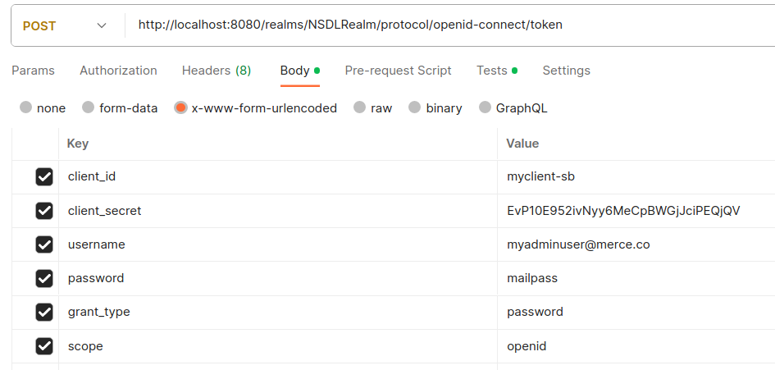
Realm+Client+User => Authentication parameters
Realm
Client
User

Slide 11
Parameters in REST API request
client_id : Keycloak Client ID. E.g. “sb-app”
client_secret : (Keycloak) Client secret. It is an Opaque String. E.g. “EvP10E952ivNyy6MeCpBWGjJciPEQjQV”
username : username of the someone trying to login. E.g. “bhavyag@merce.co”
password : password of the one trying to login
grant_type : The OAuth framework specifies several grant types for different use cases, as well as a framework for creating new grant types.
  password : The Password grant is used when the application exchanges the user’s username and password for an access token.
  client_credentials : The Client Credentials grant is used when applications request an access token to access their own resources, not on behalf of a user.
  refresh_token : To use refresh token to get a new access token.
  authorization_code : The authorization code grant is used when an application exchanges an authorization code for an access token.
scope : These are OIDC request scopes. Allowed values are:
  openid : to indicate that the application intends to use OIDC to verify the user's identity.
  profile : to get name, nickname, and picture.
  email : to get email and email_verified.

Slide 12
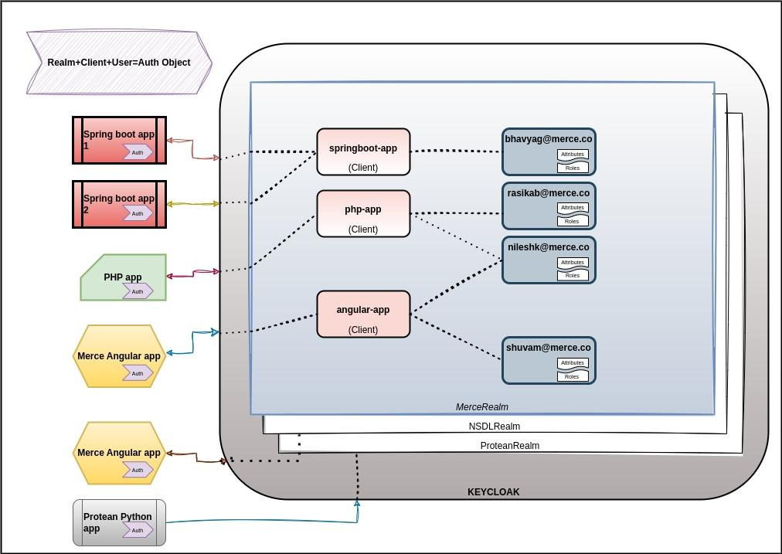

Slide 13
Realm+Client+User=Auth Obj
K
E
Y
C
L
O
A
K
Merce Realm
bhavyag@
merce.co
Spring-boot-app
(Client)
Attributes
Spring-boot-app-1
NSDL Realm
Roles
Auth Obj
Protean Realm
Spring-boot-app-2
php-app
(Client)
rasika@
merce.co
Attributes
Auth Obj
Roles
angular-app
(Client)
shuvam@
merce.co
Attributes
php-app
Roles
Auth Obj
Merce Angular app
Auth Obj
NSDL Angular app
Auth Obj
Protean Python
app
Auth Obj

Slide 14
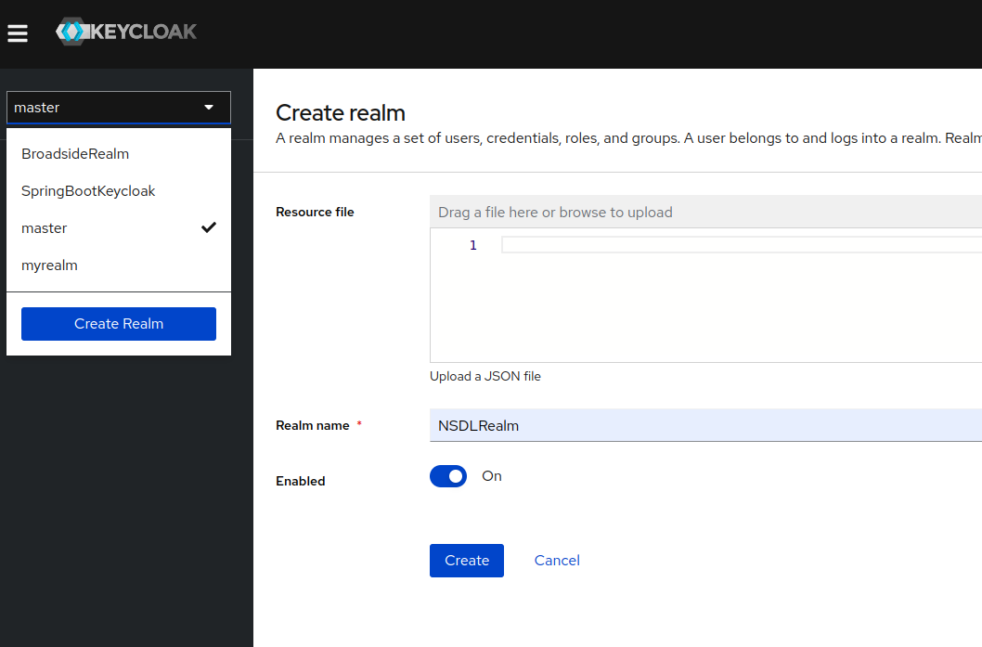
Setting up Keycloak : Realm
Open the Keycloak Admin Console.
Click the word master in the top-left corner, then click Create realm.
Enter NSDLRealm in the Realm name field.
Click Create.

Slide 15
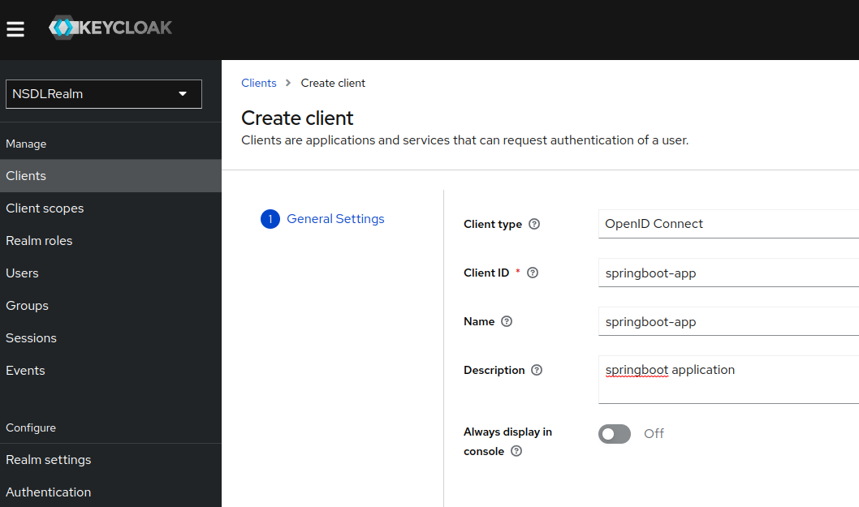
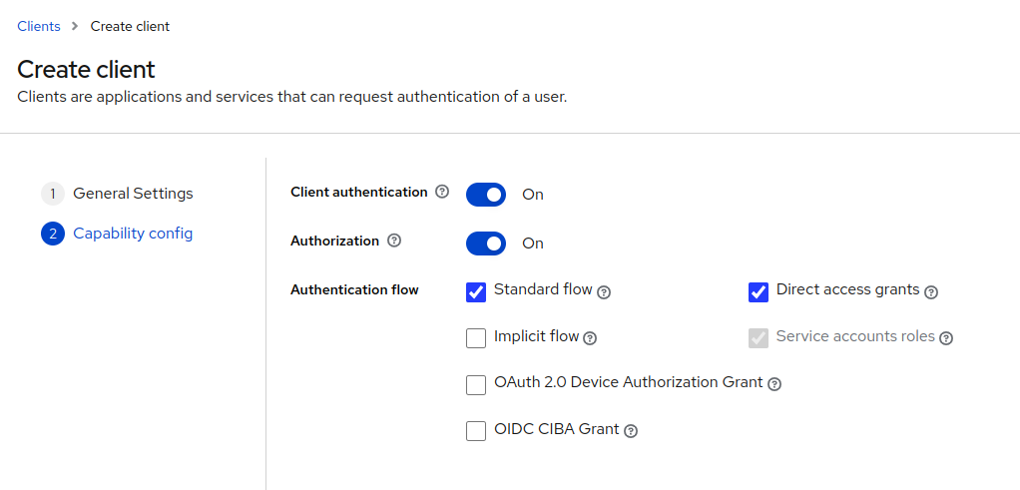
Setting up Keycloak : Client
Open the Keycloak Admin Console.
Click on master on top right corner and select NSDLRealm.
Click on ‘Clients’ in the menu bar on right.
Click on ‘Create Client’ button.
Fill in the details.
Click on Next.
Enable Client Authentication, Authorization.
Click on Save.

Slide 16
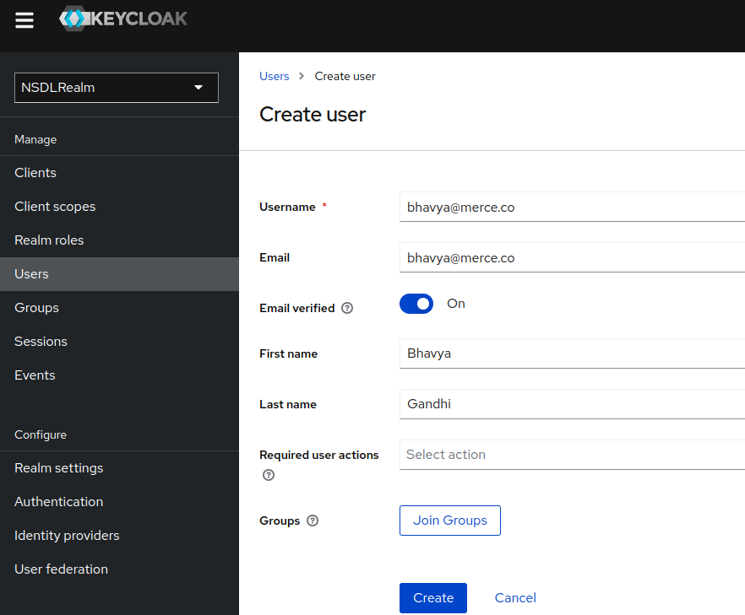
Setting up Keycloak : User
Open the Keycloak Admin Console.
Click on master on top right corner and select NSDLRealm.
Click on ‘Users’ in the menu bar on the right.
Click on the ‘Add user’ button.
Fill in details.
Click on ‘Create’.
Now go to Credentials tab and click on ‘Set password’.
Create a password for this user and click on Save.

Slide 17
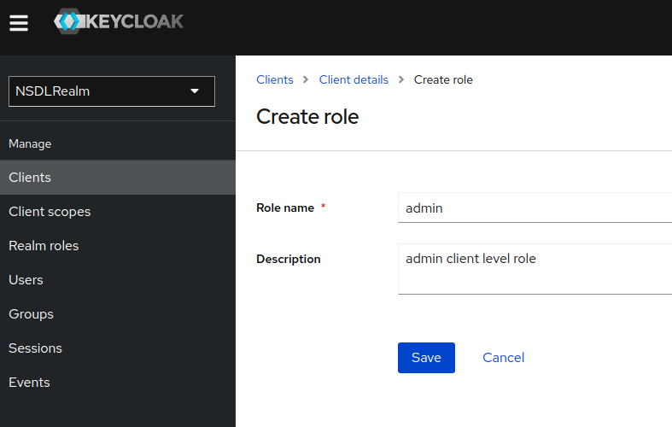
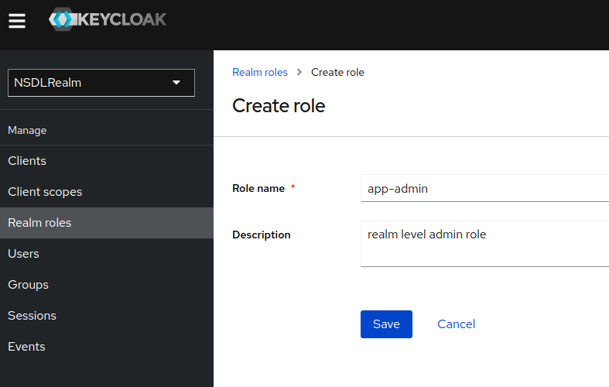
Setting up Keycloak : Role
Client Level Role
Create Client level role
  Open the Keycloak Admin Console.
  Click on master on top right corner and select NSDLRealm
  Click on ‘Clients’ in the menu bar on right
  Now click on “myclient-sb” Client we previously created.
  Click on the ‘Roles’ tab.
  Click on the ‘Create role’ button.
Create Realm level role
  Open the Keycloak Admin Console.
  Click on master on top right corner and select NSDLRealm
  Click on ‘Realm roles’ in the menu bar on right
  Click on ‘Create role’ button.
  Click on Save.
Realm Level Role

Slide 18
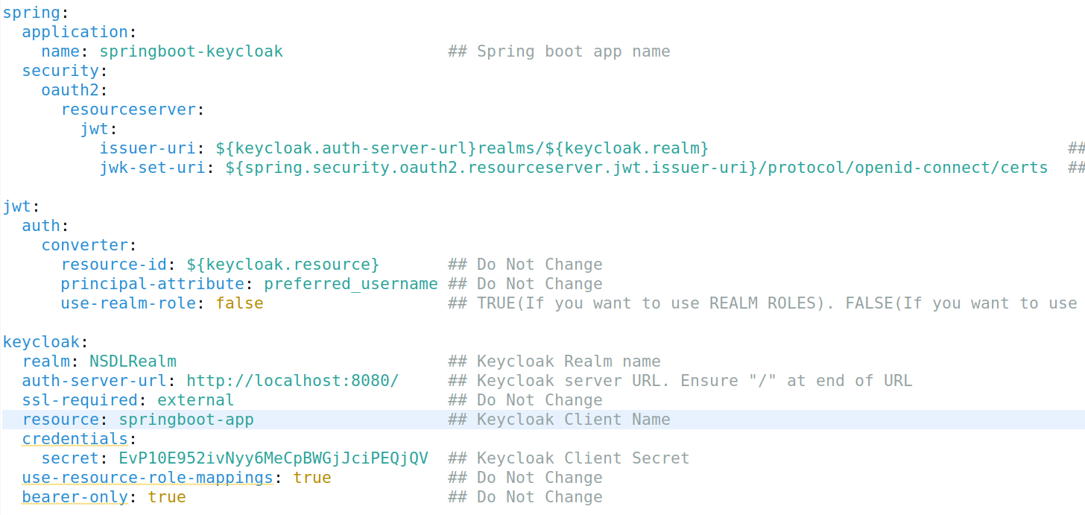
Setting up Spring Boot App: Config to use OAuth
Add following config to your spring boot app:
Realm
Client
Keycloak URL

Slide 19
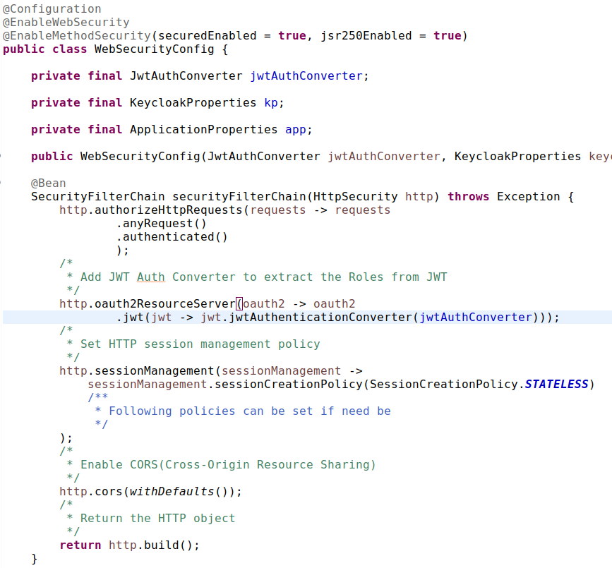
Setting up
Spring Boot WebSecurityConfig
Enable Spring Web Security
Enable Security at Method level
Custom JWT Auth Converter

Slide 20
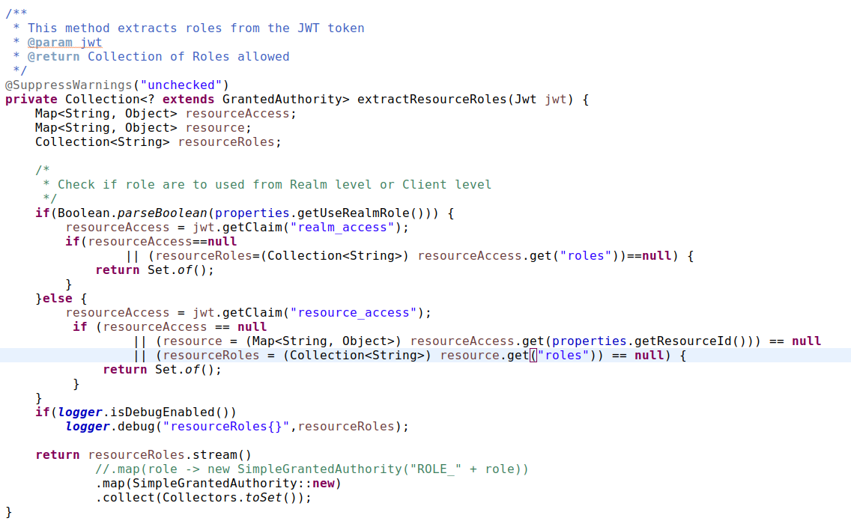
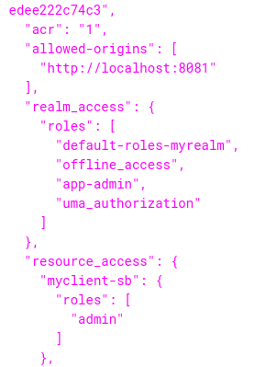
Setting up Spring Boot App: Extract Role from Token
We programmatically extract roles from JWT Token.
And then pass it on to Spring Security methods.
Sample Token
Claims

Slide 21
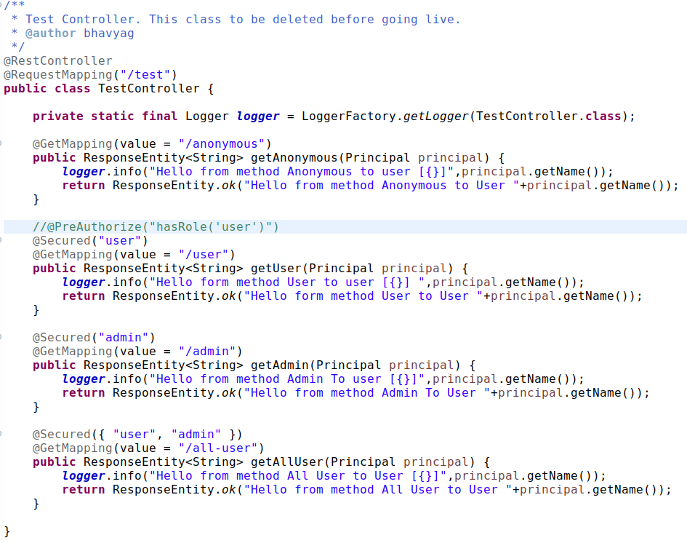
Setting up Spring Boot App: Authorization of end points
Use Spring Security annotations to mark Rest endpoints to be secured by selected roles.
The further business logic can go into these methods.
Code : https://github.com/merce-bhavyag/sb-kc-demo
End points
Roles

Slide 22
Extending Keycloak Functionalities
While exploring features of keycloak, we came across certain functionalities that we deemed important for our usage at Merce and were not a part of Keycloak Out of the Box.
We decided to extend Keycloak and write our own code to build those features.
This extension of Keycloak features can be done via SPI(Service Provider Interfaces).
Following are the functionalities that were not present in Keycloak Out of the box:
2FA authentication using Email and SMS
  SMS based OTP
  Email based OTP
Geo Location check
IP Whitelist check

Slide 23
How to create an SPI?
While there is extensive documentation on how to extended Keycloak using SPI, there are certain steps that are not very clear from the documentation.
The detailed steps to write SPI is included in a separate document, a brief overview of the steps involved are as follows:
Include Keycloak core JARs in your repository.
Extend the Factory class of keycloak you want to work with.
Write the implementation of that factory class.
Create an entry point of the factory class in the ‘META-INF/services’ folder
Compile the code to create a JAR file
Place the compiled JAR on ‘Keycloak_Installed_dir/providers’.
Also placed if any other 3rd party JARs are required in the same ‘providers’ folder.
Start the keycloak application.
Make the necessary changes in the Authentication flow etc if the SPI relates to those changes.

Slide 24
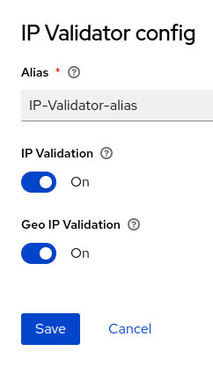
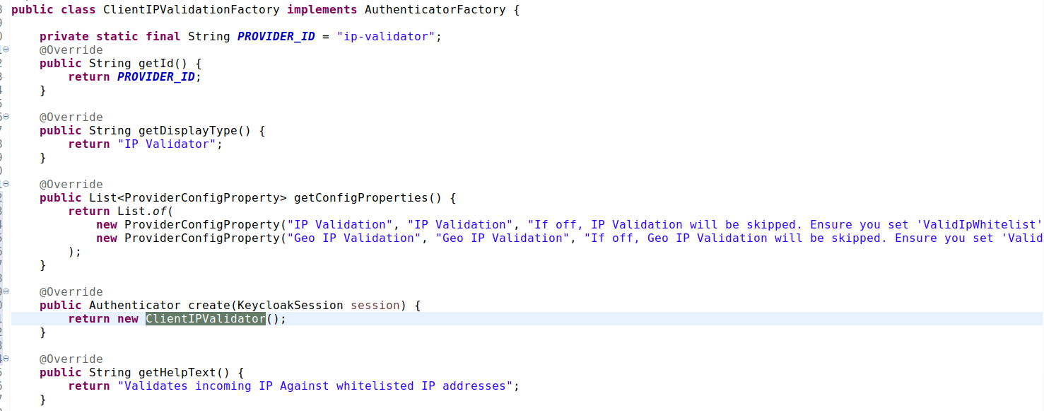
Implementing Factory Class
Extend Keycloak AuthenticatorFactory
Display name
Config items visible in Keycloak settings
Actual Authenticator class

Slide 25
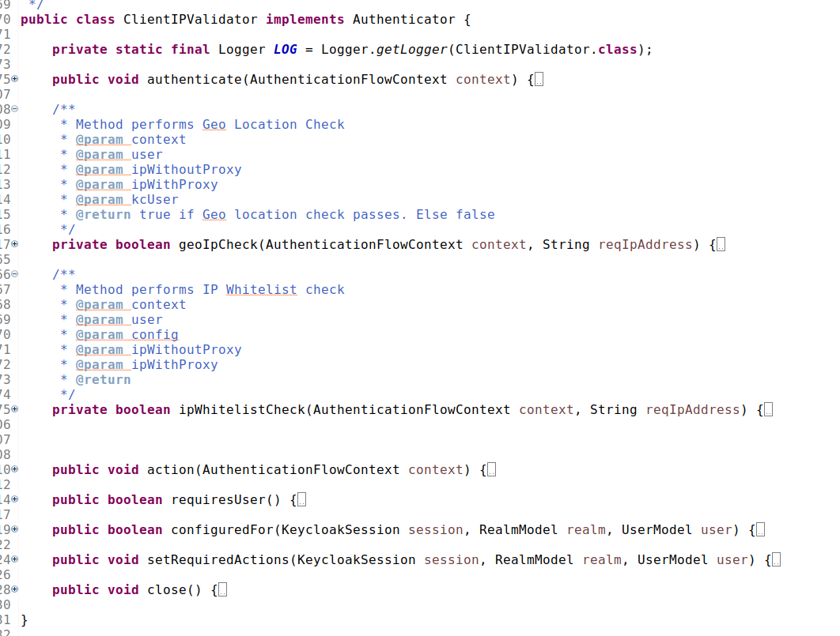
Actual Authenticator implementation
Implementation Class
Main method of actual Implementation
Custom class
Custom class
Form action invocation

Slide 26
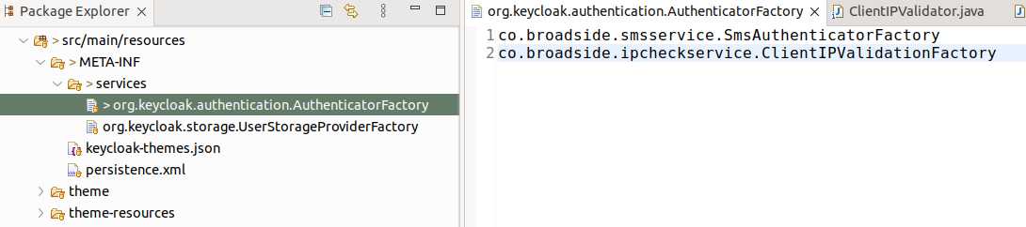
Create Entry point of our Factory class for Keycloak
Classpath of our custom class
Entry point for Keycloak to read the custom class

Slide 27
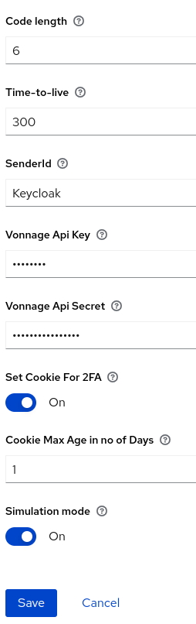
SPI : SMS/Email Based OTP
Keycloak Supports 2FA via TOTP out of the box. Setup is quite intuitive.
However, there is no SMS or Email based OTP support.
SMS Based OTP:
Setup Keycloak Authentication flow to include extra step of SMS/Email OTP
Add Vonnage API Key and API secret in the Authentication Flow.
Add Senderid, TTL, OTP Length in the settings.
Set Cookie for 2FA : If you want to remember Successful 2FA and disable further 2FA for that browser for “x” no of days.
Cookie Max Age in no of Days : The no of days the cookie is valid to disable 2FA on the browser.
Simulation mode : If you do not want to actually send an SMS but just print the OTP in the logs
Add “MobileNumber” to each user’s “attribute”.
That’s it. Now during each Browser based login, post successful validation of user creds, OTP screen will be presented to the user.
An OTP will be sent via SMS and also via Email to the user.

Slide 28
SPI : IP Whitelist
We wanted a functionality to allow only whitelisted IPs for authentication.
We added a feature to check whether IP of user logging in belongs to specific IP or Range of IP.
To enable this, we have to add step to Keycloak authentication flow to enable “IP Validator”.
Enable to config settings “IP Validation” for IP validator.
Configure the IP Whitelist to be allowed, which can be done at Keycloak Client or Keycloak User level.
If set at User level is the lower most granularity and therefore takes most precedence.
We need to set “ValidIpWhitelistRole” attribute at Role on client level or an attribute “ValidIpWhitelist” at the User level

Slide 29
SPI : GeoLocation check
We wanted a functionality to check the User’s geolocation belongs to a valid country.
For the purpose, we have used Maxmind’s geoip2 lite database.
To enable this, we have to add step to Keycloak authentication flow to enable “IP Validator”.
Enable to config settings “Geo IP Validation” for IP validator.
Configure which geolocation is allowed can be done at Keycloak Client or Keycloak User level.
If set at User level is the lower most granularity and therefore takes most precedence.
We need to set “ValidISOGeoLocation” attribute either at Role on client level or an attribute to the User

Slide 30
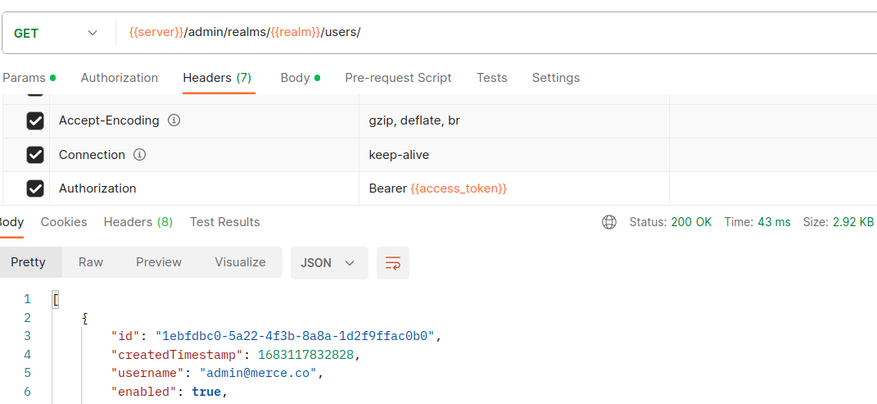
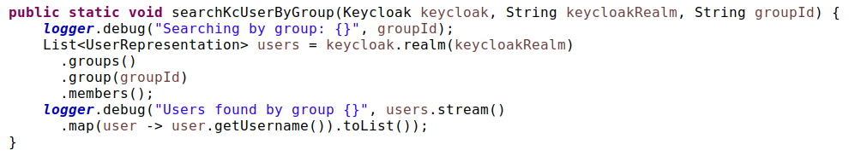
How to use the Keycloak Admin API to manage Keycloak?
Admin REST API
We can use they Keycloak’s REST based admin API to manage keycloak.
The admin API can manage most things in keycloak provided the user you are using have the correct roles configured.
While working with Java, we came across libraries that makes it easy to manage these via wrapper classes over Keycloak’s REST API.
Documentation : https://www.keycloak.org/docs-api/21.1.2/rest-api/index.html
Java Library

Slide 31
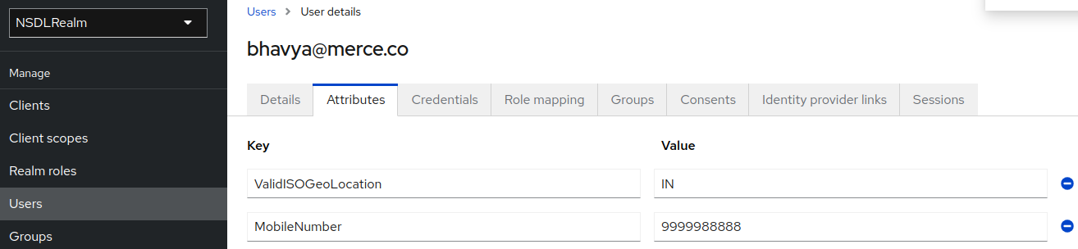
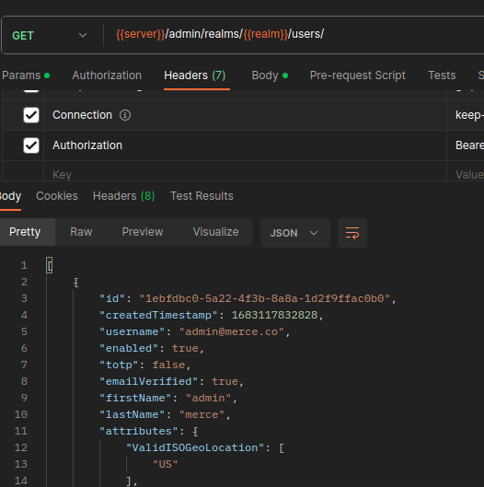
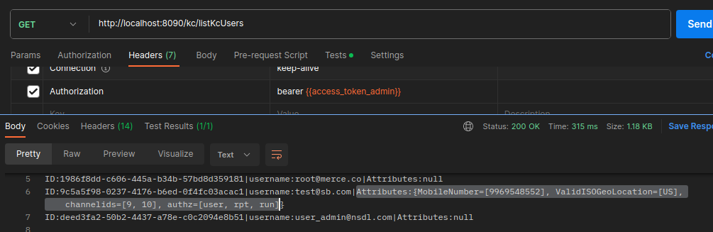
How do I add custom attributes to Keycloak User?
Keycloak’s User has a section called “attributes”.
This is for custom fields/attributes to be attached with the user for example “mobile no”, “geoLocation” etc.
It is basically a Key-Value pair where Key is a unique String and value can be Number or String or JSON.
These attributes can be seen in the Keycloak Admin portal, can be accessed via the Admin API.
By defining custom mappers, we can embed these attributes within the access token for the user as well.
Keycloak UI
Java API
Admin REST API

Slide 32
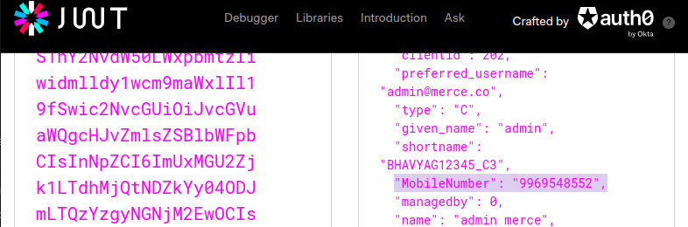
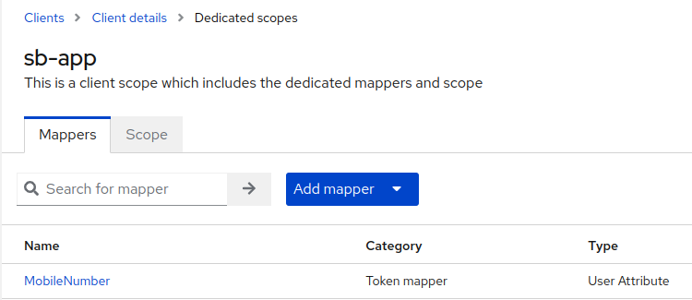
Adding User attributes to Access Token
We can define custom attributes for a Keycloak Client and these attributes can then be embedded into the token by Keycloak
Data as part of Token
Add Attribute Mapper

Slide 33
Thank You

