Slide 1
Keycloak for Auth and user Management
Part 3

Slide 2

Keycloak In Angular Application

Slide 3
What are we going to learn today?
Keycloak Configure
Keycloak Integration Steps in Angular Project
  Feature
  Auth Guard
  Interceptor
Keycloak Theme Development

Slide 4
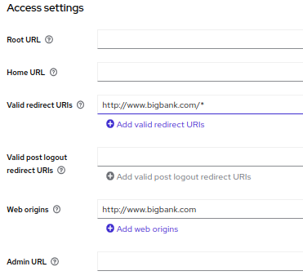
Keycloak Configure
Redirect URI
Installation and configuration of Keycloak
After Installation and configuration, have to do some additional changes for frontend as below:
  By specifying "http://www.bigban.com/*" as a valid redirect URI, you're essentially allowing Keycloak to redirect the user back to any page or path within your Angular application after authentication or authorization.
  we also need to configure Web Origin in Keycloak so that it returns the Access-Control-Allow-Origin header when the request comes from these Web Origin
Web Origin(CORS)

Slide 5
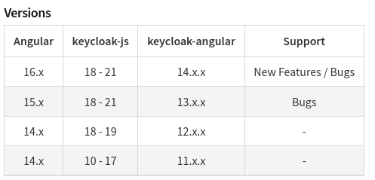
Keycloak Integration Steps in Angular Project
Installation of Keycloak Packages according to angular version:
  npm install keycloak-angular keycloak-js
Check versions of installed packages
Note: For this demo we are using Angular 14, which is why
I ran the npm install keycloak-angular@12 and keycloak-js@18 commands compatible with my version.

Slide 6
Feature of Keycloak-angular
These features will be available after installing this package:
init(options: KeycloakOptions): Promise<boolean>
  This function initializes the Keycloak client with the provided options.
  It returns a Promise that resolves to a boolean value indicating whether the initialization was successful.
login(options?: KeycloakLoginOptions): Promise<void>:
  Initiates the Keycloak login flow, redirecting the user to the Keycloak login page.
  You can provide additional options, such as specifying the login action or the ID of the client to authenticate against.
logout(redirectUri?: string): Promise<void>:
  Logs out the current Keycloak user and optionally redirects them to the specified URL after logout.
  If no redirectUri is provided, the user will be redirected to the Keycloak login page.

Slide 7
Feature of Keycloak-angular
getToken(): Promise<string>:
  Retrieves the current Keycloak access token as a Promise.
  You can use this token to include in API requests to authenticate the user.
getTokenParsed(): KeycloakTokenParsed:
  Returns the parsed representation of the current Keycloak access token.
  The parsed token contains information about the user, such as their roles, username, and other custom claims.
hasRealmRole(role: string): boolean:
  Checks whether the current user has the specified realm-level role.
  Returns true if the user has the role; otherwise, returns false.
hasResourceRole(role: string, resource?: string): boolean:
  Checks whether the current user has the specified resource-level role for the given resource.
  Returns true if the user has the role; otherwise, returns false.
loadUserProfile(): Promise<KeycloakProfile>:
  Fetches the user's profile information from Keycloak.
  Returns a Promise that resolves to a KeycloakProfile object containing the user's details.

Slide 8
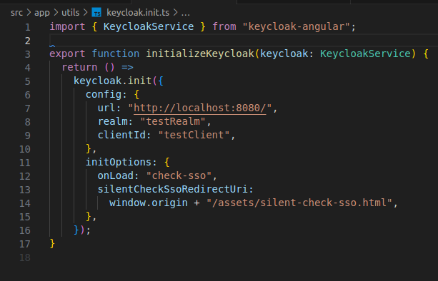
Keycloak Initialization
To initialize keycloak we are using init() method in this method we pass the configuration which we have in environment file.
Additional we pass initOption which is optional

Slide 9
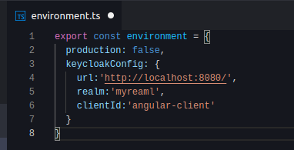
Keycloak Config in Angular
Keep the init config params in a separate config file
That way we can have separate config for different environments like dev, UAT, production

Slide 10
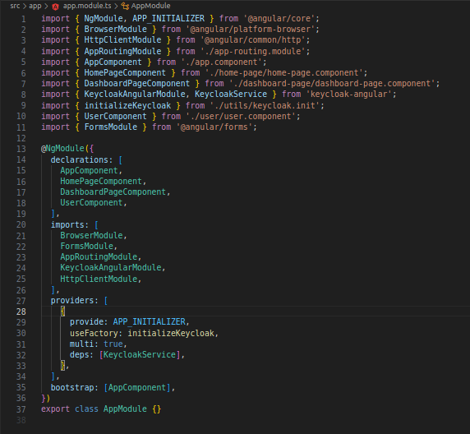
AppModule
Import KeycloakAngularModule, KeycloakService, and APP_INITIALIZER in your AppModule
Import initializeKeycloak from utils/keycloak-initializer

Slide 11
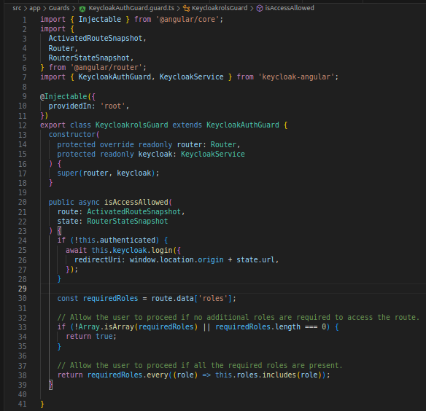
Guard Configuration
Auth Guard:
  AuthGuard is an angular route guard used to protect the routes from unauthenticated people.

Slide 12
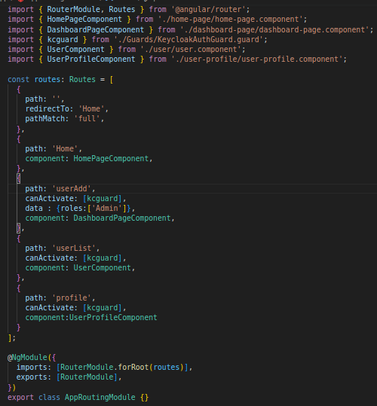
Guard Configuration
Add AuthGuard to Your Route:
  It is implemented using the canActivate interface which implements a canActivate function that checks whether the current user has permission to activate the requested route.

Slide 13

Interceptor
Angular HttpInterceptor
  Transforms requests before sending them out
Keycloak-Angular HttpInterceptor:
  Add the Authorization header in the format of:
Authorization: Bearer **_TOKEN_**
  Enabled by defaut
Some end points can be excluded

Slide 14
Demo

Slide 15
Keycloak Theme Development
We can modify this UI page according to our requirements.
The following theme types can be modified:
  Login
  Account
  Email
  Admin

Slide 16
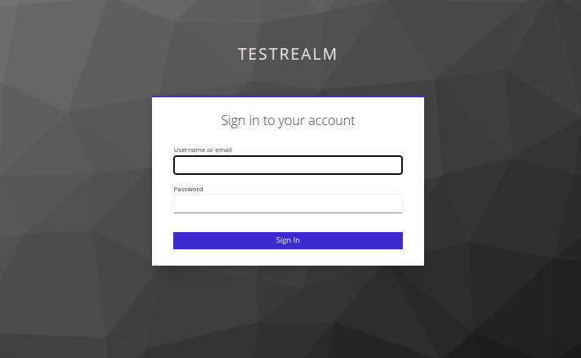
Keycloak Theme Development

Slide 17

Keycloak Theme Development

Slide 18
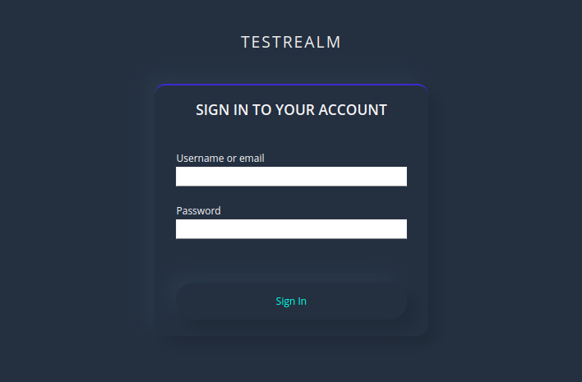
Keycloak Theme Development

Slide 19
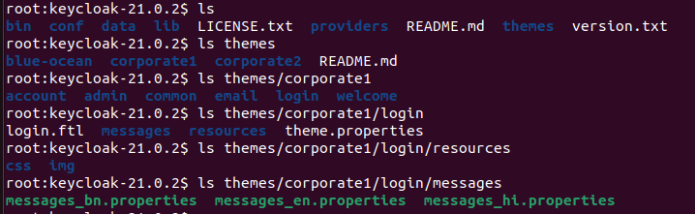
Keycloak Theme Directory
Folder Structure
Themes
Theme Folder Structure
i18n

Slide 20
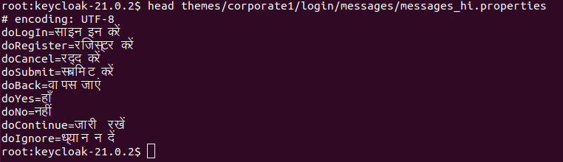
Keycloak i18n

Slide 21
Theme Template
Templates are defined using Freemarker templating library
It is an Apache open source project
Features:
  Conditionals
  Loops
  Functions for strings, numbers, datetime, and so on
Access to Keycloak objects like realm, properties, social

Slide 22
Q & A

Slide 23
Thank you!

